Slide 1

Command Base

Slide 2
What is “command-based” programming?
Command-based programming is a design pattern
Command-based programming uses callbacks to execute code when needed
Button presses, for example, tell the scheduler that code needs to be run

Slide 3
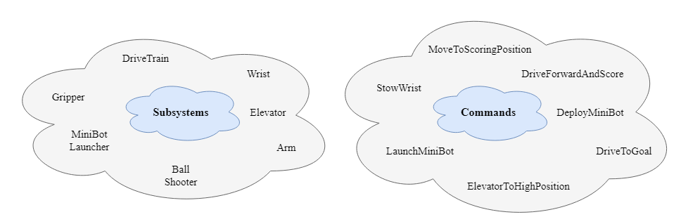
Two main components

Slide 4
What are subsystems?
Subsystems are an encapsulation of the robot’s hardware
Each “module” of the robot gets its own subsystem
They handle the states of various hardware of the robot

Slide 5
Hardware controlled by subsystem
Motor: It Spins requires power, power determines spin
Limelight: Light tracking camera
LED: Programmable colorful lights
Sensor: Senses things
Color sensor
Touch sensors
Distance sensors
Camera: Returns Visuals
Gyro: Rotation Information (angular rotation)
Pigeon(IMU): Position on field
Creates robot compass
Encoder: Gear teeth counter
Notes:
Piston: “Pushy Pushy Pully Pully”(Anthony)

Slide 6
What are commands?
Commands are the “actions” of the code
Commands can involve multiple subsystems and other commands
Unlike subsystems, commands can be instantiated multiple times over the lifecycle of the program

Slide 7
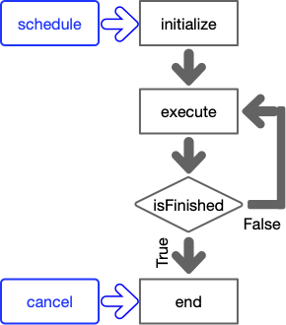
How do you make a command?
Commands consist of four main parts:

Slide 8
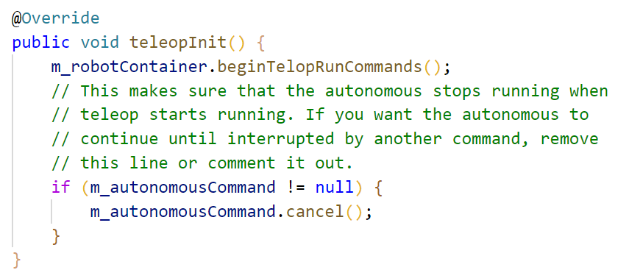
How does the robot work?
Every robot starts with a file called Robot.java
This file takes care of telling the robot which mode to run
Robot.java almost always calls functions in RobotContainer.java

Slide 9
How the robot works (continued)
RobotContainer.java
Sets up all the options used by the robot
Initializes subsystems and buttons
Binds the commands to buttons

Slide 10
What is the command scheduler?
The command scheduler is singleton that must be called from the robotPeriodic() function
When called it does a couple of things including running the periodic methods of a subsystem, polling triggers such as buttons, running scheduled commands, and running default commands

